Slide 1

—— 赵郑洁 Nancy
—— 李佳怡 Leona
—— 齐军 Oliva
—— 戴方华 Elias
—— 况小媛颖 Joy
—— 王月姮 Lin
Group 3
CST2201
5.5 Greywater treatment

Slide 2
—— 赵郑洁 Nancy
01
Introduction

Slide 3

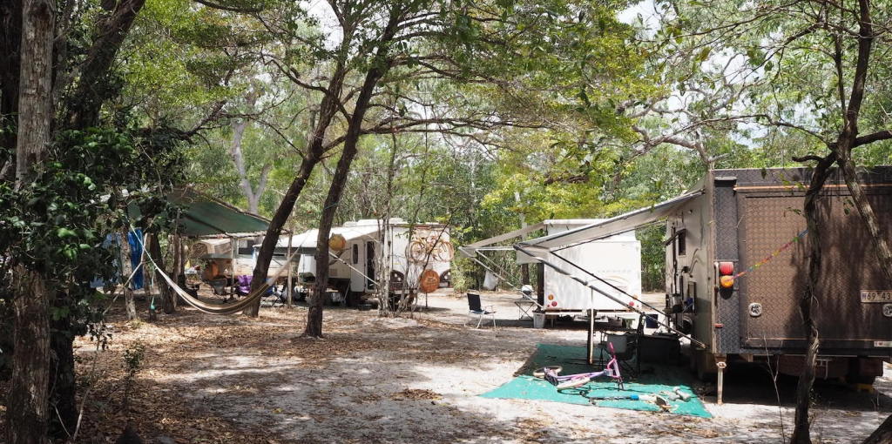
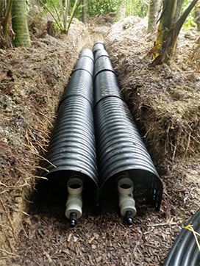
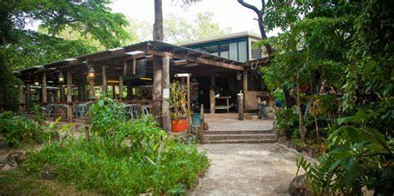
—— 赵郑洁 Nancy
camping
the current greywater trenches

Slide 4
—— 赵郑洁 Nancy
02
Background

Slide 5
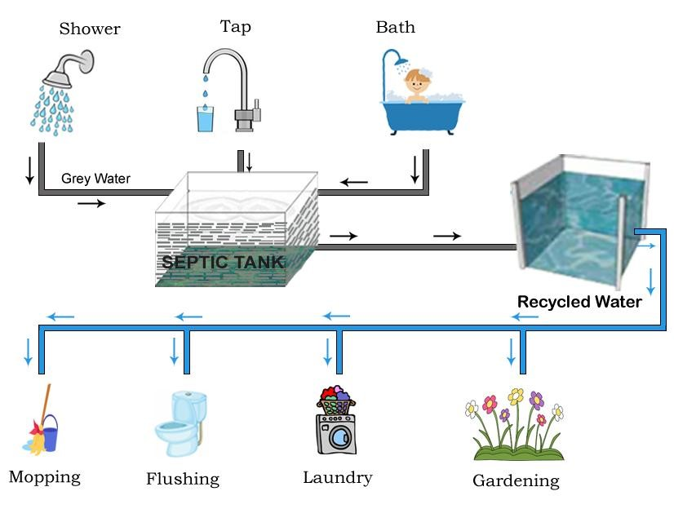
—— 赵郑洁 Nancy
recycle greywater

Slide 6



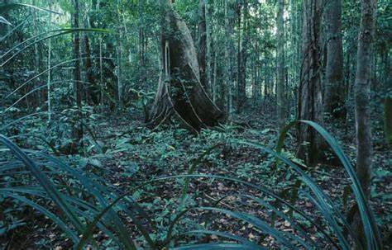
—— 赵郑洁 Nancy
rainforest
native plant
algae and fungi which as the principal decomposers in many ecosystems has the ability to improve water quality

Slide 7
—— 齐军 Oliva
03
Design options

Slide 8
—— 齐军 Oliva
3.1
Design Criteria
Accessibility of construction
High safety performance
Low cost
High efficiency
02
04
06
08
01
03
05
07
Culturally appropriate
Environmental protection
Technical enforceability
Energy utilization:

Slide 9
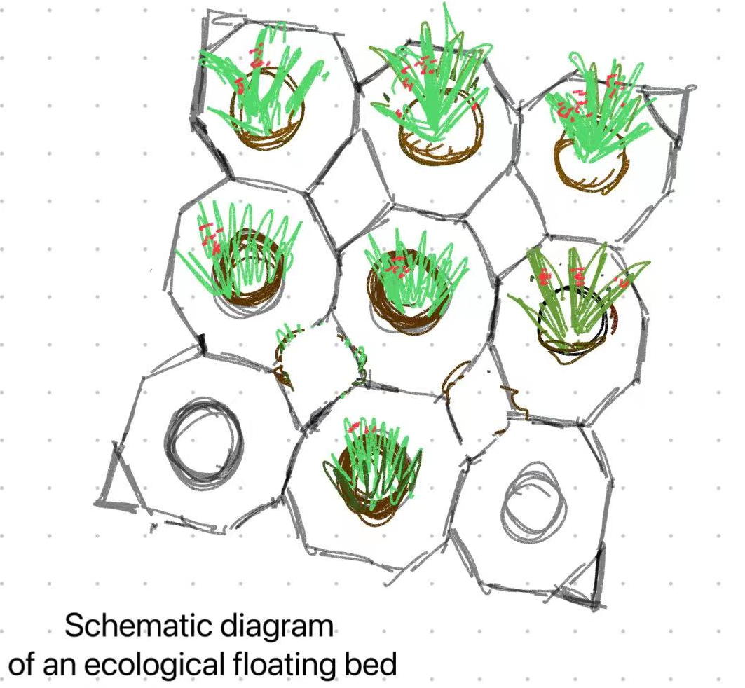
—— 齐军 Oliva
3.2
Design options
Design option 1 –Artificial floating island
Working mechanism: The roots of plants from huge webs in the water that effectively absorb suspended solids, while it can also provide oxygen for a variety of microorganisms, so that water pollution can be repaired and a benign ecological balance environment is formed.

Slide 10
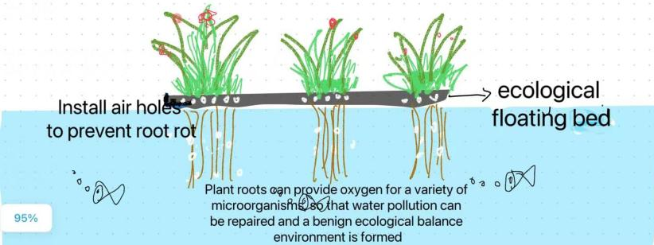
—— 齐军 Oliva
The project can directly utilize the water area and combine landscape design with water restoration. However, different lakes, their water conditions are different, cultivation is not easy to carry out standardized popularization and application, at the same time, it is very inefficient

Slide 11
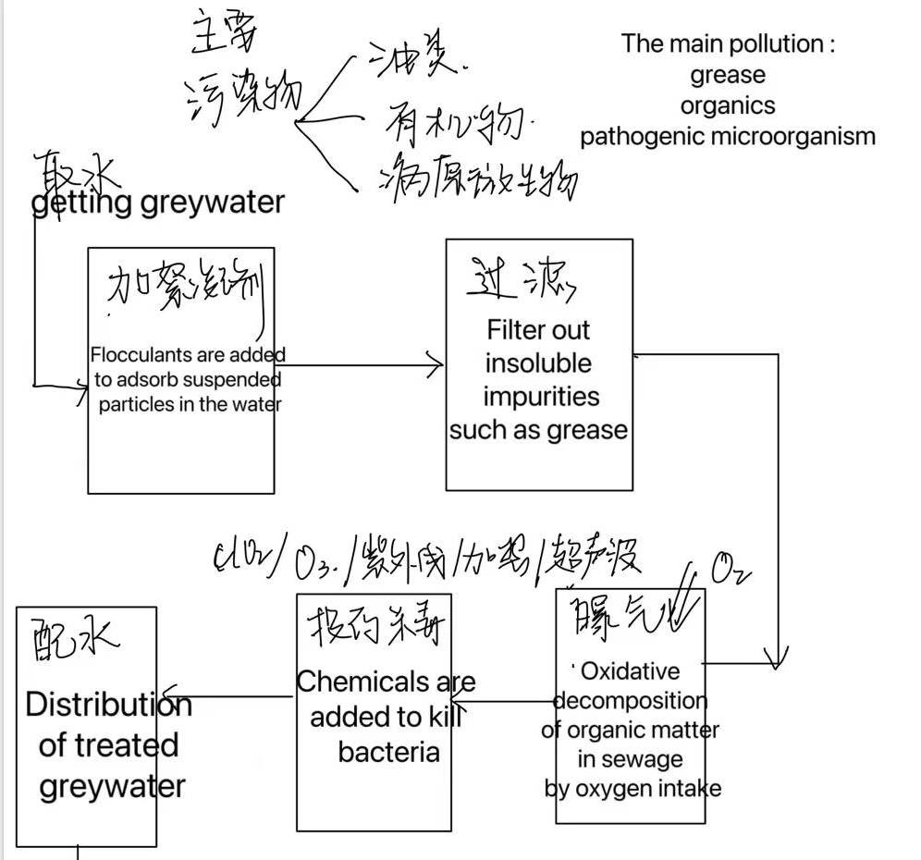
—— 齐军 Oliva
3.2
Design options
Design option 2 –Chemical treatment method
The methods of aeration and disinfectant are used in the important links, the first step is to oxidize and decompose the organic matter in the sewage by inhaling oxygen, and the second step is to kill the fine bacteria by adding chemicals (such as ClO2,O3).

Slide 12
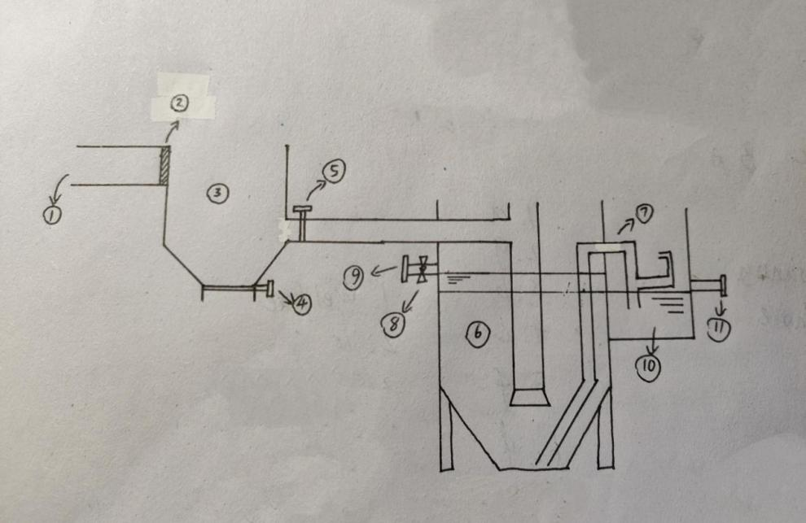
—— 齐军 Oliva
3.2
Design options
Design option 3 –Physical adsorption precipitation method
The solution combines adsorption, precipitation and separation, and completes the graywater treatment with low cost, low pollution and high efficiency through the treatment device running synchronously at different stages, so as to achieve the application of non-drinking water in household, industrial and agricultural fields.

Slide 13
—— 齐军 Oliva
3.3
Option Selection
Design options Design criteria | Artificial floating island | Chemical treatment method | Physical adsorption precipitation method
Culturally appropriate | 4 | 2 | 3
Low cost | 4 | 1 | 5
Environmental protection | 5 | 1 | 4
Accessibility of construction | 3 | 2 | 4
Technicalenforceability | 2 | 4 | 4
High efficiency | 1 | 5 | 4
Energy utilization rate | 1 | 4 | 4
High safety performance | 5 | 1 | 5
Total | 25 | 20 | 33

Slide 14
—— 况小媛颖 Joy
04
Proposed Design and Implementation Plan

Slide 15
—— 况小媛颖 Joy
Final design
Greywater collection device
Our final design scheme will be divided into three processes, namely collection, processing and export. The following will be analyzed and studied from these three aspects respectively.
Greywater processing device
Greywater exporting device

Slide 16
—— 况小媛颖 Joy
Part1: Greywater collection device

Slide 17
Greywater collection device
—— 况小媛颖 Joy
The greywater produced in the camping life is mainly from washing area and cooking area.
The greywater that people produced in washing area like bath water, laundry water is collected by drainage pipe and pooled into the water tank.
The greywater that people produced in cooking area like water used to wash vegetable, dishwashing water is collected by pipe and pooled into the water tank.
washing area
cooking area
The greywater collected from washing area and cooking area are pooled in the greywater treatment device.
confluence
prototype

Slide 18
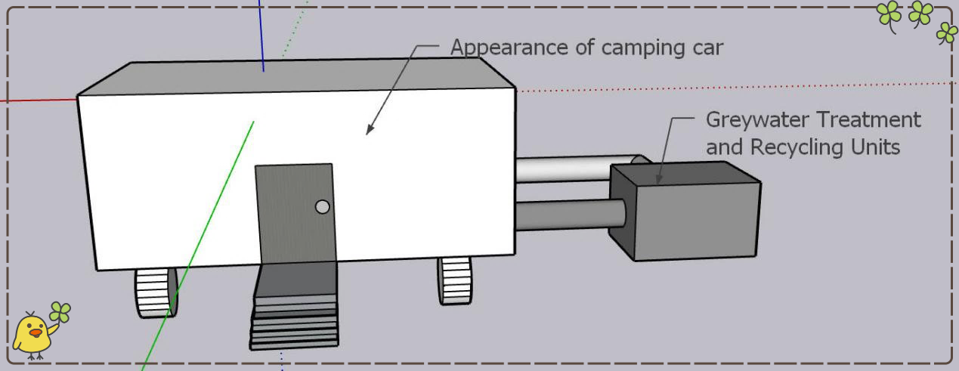
—— 况小媛颖 Joy
Figure1: The outside of the design

Slide 19
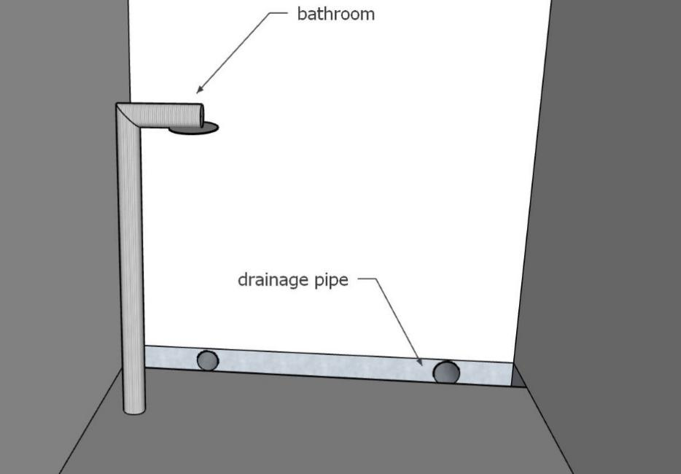
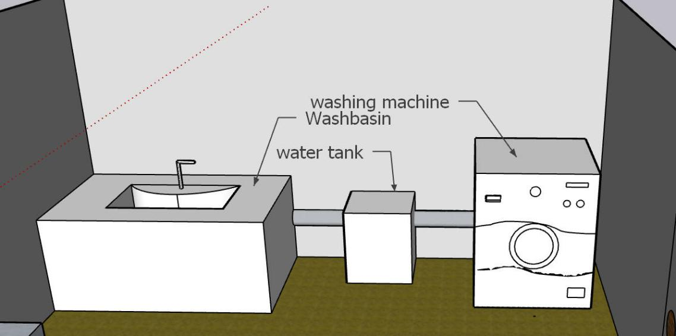
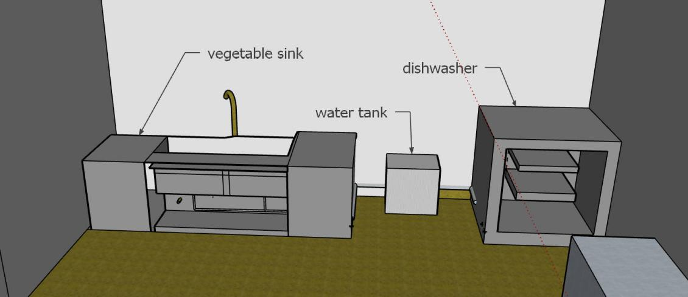
—— 况小媛颖 Joy
washing area
design
cooking area
design
shower room
design

Slide 20
—— 况小媛颖 Joy
Implementation Plan
The physical implementation of this project requires a number of components and other equipment:
drainage pipe: to collected the bath water from bathroom.
water tank: Temporarily collect greywater in the corresponding area.
Component List:
The implementation of the collection device should be in cooperation with the national park official, using the park's publicity efforts to raise public awareness, strengthen the importance of tourism graywater treatment, and promote the application of the collection device.
Practical spread
Practical
maintenance
1、Arrange regular inspection by staff.
2、Progressive maintenance guide

Slide 21
—— 况小媛颖 Joy
Part2: Greywater exporting device

Slide 22
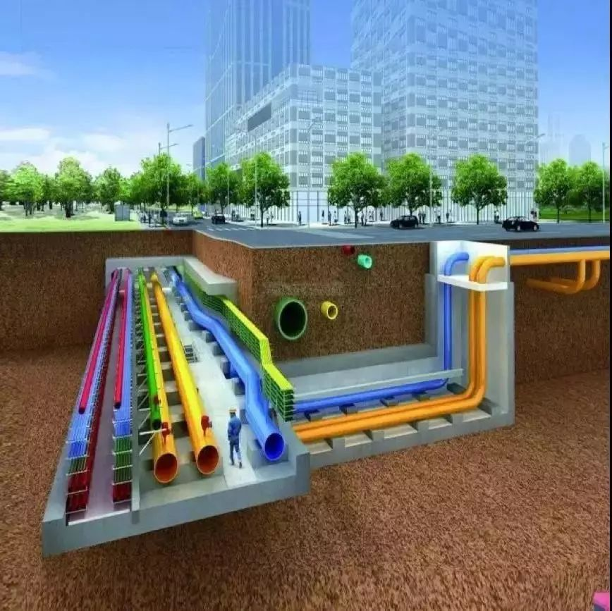

—— 况小媛颖 Joy
Greywater exporting device
Use pipes to feed into the original water pipeline for household and factory use.At this stage, the original pipelines in the area can be used to transport the treated sewage into the anywhere, taking advantage of the advantages of the pipelines in the underground linking the whole area.

Slide 23
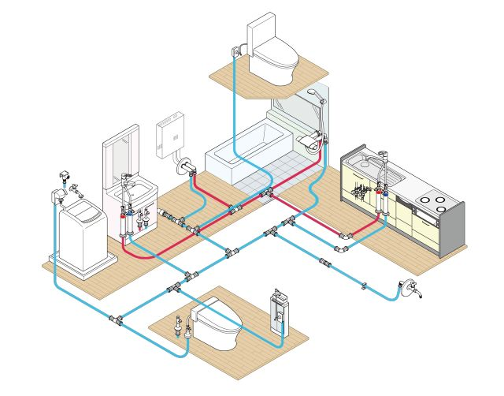
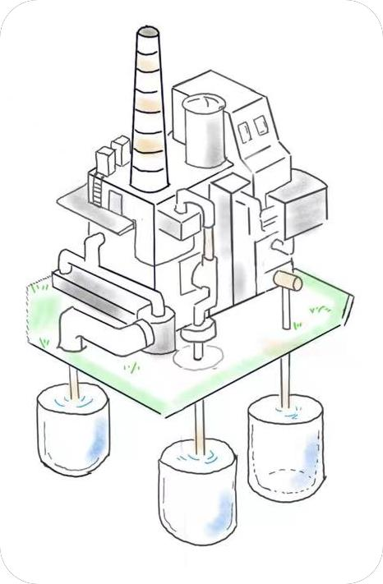
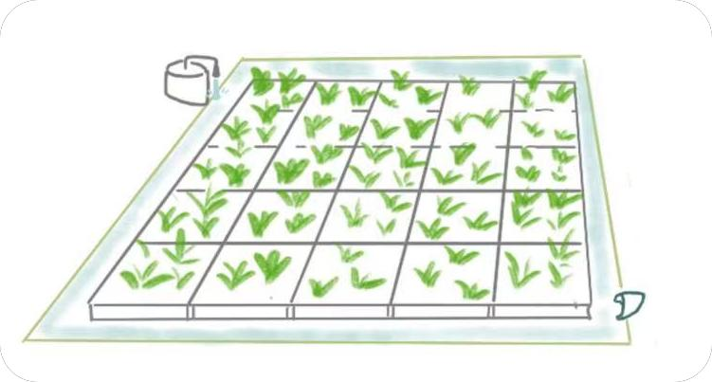
—— 况小媛颖 Joy
houshold
Industry
As shown in the figure, the red line represents the drinkable pure water, and the blue line represents the water with lower requirements for cleaning and flushing. The water that we treat thoroughly can be used for drinking, and the water that is treated less thoroughly and simply can be used for flushing.
Agriculture

Slide 24
—— 况小媛颖 Joy
Implementation Plan
Implementation object
Municipal personnel: related to public infrastructure.
The project contractor: hiring local labors.
Working with local authorities to borrow existing pipeline facilities.
Improve publicity efforts to do pipeline classification in residents' homes.
Practical spread
Regular dredging of pipes.
Testing of export water resources
Practical
maintenance

Slide 25
—— 戴方华 Elias
Part3: Greywater treatment device

Slide 26
—— 戴方华 Elias
Greywater treatment device
The picture above is the sectional drawing of the physical treatment of grey water device. This device is used for centralized physical treatment of grey water.
① in the picture is water inlet. ② is a sieve.③ is the adsorption pool, while ④ and ⑤ are valves. Before the grey water enter the adsorption pool, ④ and ⑤ must be turned off to control the water flow and prevent the grey water from escaping. After the grey water flows into the adsorption pool, alum and activated carbon will be added into the pool to absorb the large granular impurities in the grey water. After complete adsorption, the large granular impurities in the grey water are basically cleaned up. Then we can open the valve ⑤ for the next step. After the grey water enter the settling pool, we can open the valve ④ to clean the used alum and activated carbon out.
⑥ is the settling pool. Here greywater will sit for a while in order to settles, and then small granular impurities will be removed. ⑧ is the electric valve and ⑨ is water outlet. After the process of the physical treatment of grey water is over, the electric valve should be opened to control grey water that has been treated to leave the device. Meanwhile, the pulse can cause silt inside the settling pool to pass from the sludge pipe ⑦ into the sludge tank ⑩ . Also, silt in the sludge tank can be cleaned out when valve ⑪ is opened.

Slide 27
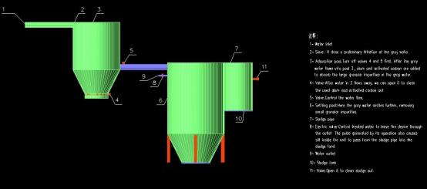
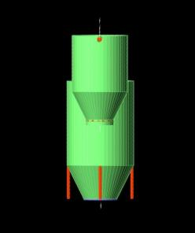
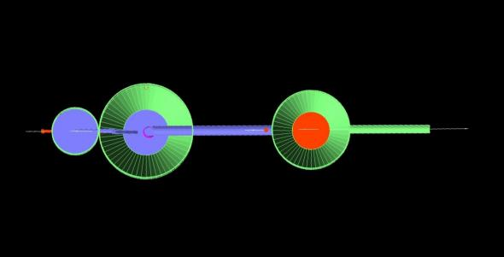
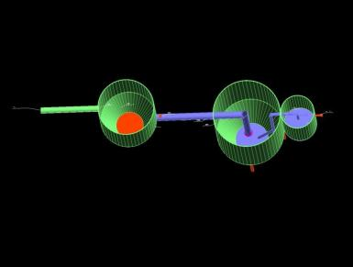
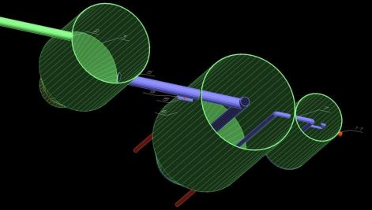
—— 戴方华 Elias
Screenshots of the device

Slide 28

—— 戴方华 Elias
Material Section
As one of the major producers of bauxite in the world, Australia's aluminum has advantages in production and quality. On the other hand, the material for manufacturing this device needs to be resistant to corrosion. The use of aluminum alloy to manufacture physical grey water treatment devices not only reduces the cost of manufacturing devices, but also reduces the cost of subsequent maintenance and repair equipment to a certain extent, and can also better meet the needs of physical grey water treatment devices.

Slide 29
—— 戴方华 Elias
Estimated cost
Estimated
size
The volume of the domestic sewage adsorption tank is 1 cubic meter, and the volume of the domestic sewage sedimentation tank is 2 cubic meters.
The price of aluminum alloy is 20,000 yuan per ton.
The price of electronic valves for sewage treatment ranges from 400.00 yuan to 27,000 yuan
material cost
such a physical grey water treatment unit costs about 70,400 yuan. Translated into Australian dollars, this is $14,575. 1941.
Total estimated cost

Slide 30
—— 李佳怡 Leona
05
Cost Analysis

Slide 31
—— 李佳怡 Leona
5.Cost Analysis
Greywater collection device
Greywater treatment device
Greywater exporting device

Slide 32
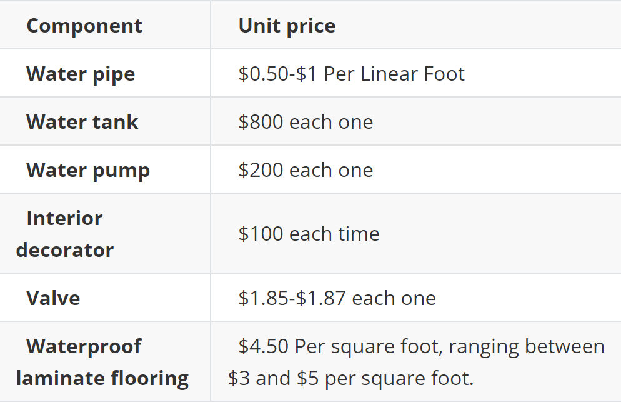
—— 李佳怡 Leona
5.1
Cost Analysis-
Greywater collection device
The cost of the greywater collection device mainly includes material cost and construction cost.
Material costs mainly include water pipes, storage tanks, waterproof floors, pumps and valves.
Construction costs mainly consider workers' wages.

Slide 33
—— 李佳怡 Leona
5.2
Cost Analysis-
Greywater treatment device
the price of bauxite per cubic meter is 2700 yuan.
the price of aluminum alloy per cubic meter is 27,000 yuan.
the price of electronic valves for sewage treatment ranges from
400.00 yuan to 27,000 yuan.
Adding up the costs required for these components means that the manufacture of such a physical grey water treatment unit costs about 70,400 yuan. Translated into Australian dollars, this is $14,575.1941.

Slide 34
—— 李佳怡 Leona
5.3
Cost Analysis-
Greywater exporting device
During the process of using the greywater which has been dealt with, the main cost is the choice of pipe material, length, and the cost of laying the pipe.
Stainless steel is about 2940.00052 AUD per ton.
The maintenance of 1 meter long, 300 diameter pipe about the need 637.39492 AUD.

Slide 35
—— 王月姮 Lin
06
Discussion

Slide 36

—— 王月姮 Lin
6.1 How to meet the needs of the client?
Our design is aimed at treating the greywater to mitigate environmental harmful impacts.
We design the physical device to purify the greywater by adsorption and precipitation.Though the greywater treated is still unable to drink directly,it can reuse in industry and agriculture areas.

Slide 37
—— 王月姮 Lin
6.2
The benefits and impacts in culture, environment, economic?

Slide 38
—— 王月姮 Lin
Water is one of the most important part of local culture,because they depend on it for survival generations after generations.We will communicate with local people to learn about their culture and belief sincerely before the project stars.
Our design must be based on protecting and respecting local traditional culture.Regarding the maintenance and construction of facilities,we also organize some activities to impart knowledge and share experience with local people,which would promote cultural exchange and social development.
Culture and social

Slide 39
—— 王月姮 Lin
The greywater is not released into environment directly by carrying out our design.It would reduce people's impact on the natural environment and maintain the local ecological balance.
Moreover, our approach to purification is primarily physical,which is almost environmentally friendly comparing to other methods.And our design materials can be recycled to improve people’s life in different areas.
Environment

Slide 40
—— 王月姮 Lin
Because of the unique natural landscape and colorful culture in Cape York,more and more people come there for exploring the mystery and experiencing aboriginal life.
However,the local infrastructure is not adequate to satisfy tourist’s needs.Our project is designed to treat greywater during visiting activities.
Our design can improve visitor’s satisfaction and recognition,which boost the development of tourism partly.
Moreover,our design realize the secondary utilization of water resources ,which improve efficiency and save costs.
Economic

Slide 41
—— 王月姮 Lin
6.3
How will the client,community and other stakeholders be engaged in the project?

Slide 42
—— 王月姮 Lin
For government
For local people
For company
The local people can be participated in this project as the simple labour.Moreover,the local people actively responded to the work of the government, took the initiative to join the propaganda team, expanded the influence of the project, and enhanced the public's conviction of it.
The company need to conduct comprehensive and systematic surveys to gain a deeper and more systematic understanding of Cape York's human geography.And the company also evaluate and improve the project so that it can be carried out successfully.
The government acts as the bridge to communicate with local people,The government strengthened publicity to help the masses actively accept the implementation of new projects.

Slide 43
—— 王月姮 Lin
6.4
Strengths/weaknesses

Slide 44
—— 王月姮 Lin
Strengths:
For materials
For implement
we choose the aluminium alloy as the main building materials.It has light and high strength and strong corrosion resistance,which is appropriate to local environment.And Aluminum alloy is easy to process, shape and weld, can be made into a variety of shapes.So it is widely used in industry.The last,the auminum alloy can be recycled,which is conducive to environmental protection and resource saving.
We choose the physical method to treat greywater instead of using chemicals,which reduce the pollution to the environment.Moreover, the operation is simple and convenient and the purification efficiency is high,which is appropriate to be used by local people.

Slide 45
—— 王月姮 Lin
Weaknesses
For materials
Limitations of application
The high temperature resistance of aluminum alloy is poor, and it is easy to soften and oxidize at high temperatures.Moreover,it is complicated and costly to make large-scale aluminum alloy.
Because we choose the physical method to treat greywater, the treated sewage still contains impurities.Therefore,this design’s application is also be limited.

Slide 46
Our presentation is over,
thanks for listening

